Slide 1
MBTI Personality Classification
JiaShuyi Fanclub
Team members: Jia Shuyi, Victoria Yong, Praveen
Notes:
Good afternoon Profs, our team is called Jia Shuyi fanclub, named after Jia Shuyi himself, and our other team members are Victoria and Praveen.

Slide 2
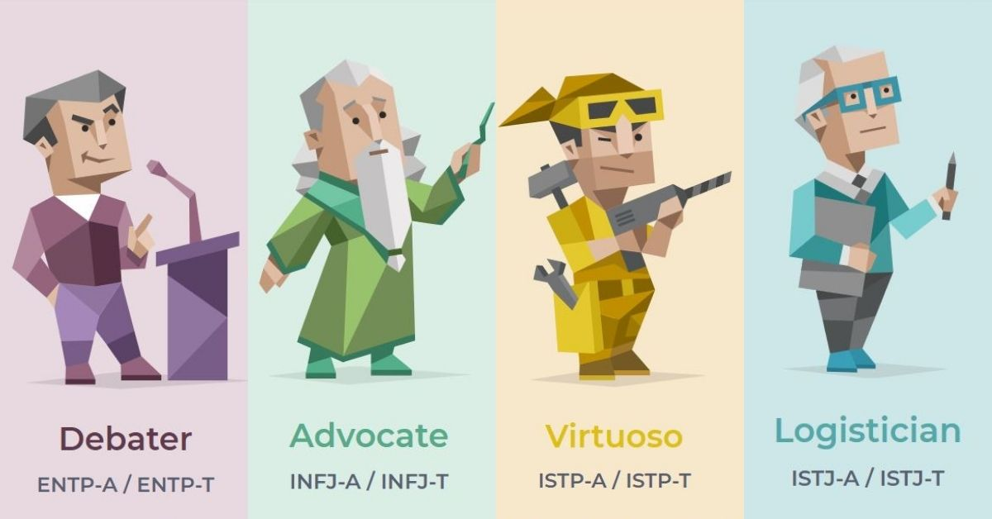
The Problem Statement
Predict MBTI (Myers Briggs Type Indicator) personality codes based on social media posts.
16 classes (4-letter MBTI code)
Extroverted (E) vs Introverted (I)
Intuition (N) vs Sensing (S)
Feeling (F) vs Thinking (T)
Judging (J) vs Perceiving (P)
INTJ
...
String of texts
MODEL
INTP
...
ESFP
Notes:
The problem we are addressing is the prediction of the Myers Briggs Type Indicator personality, otherwise commonly known as the MBTI personality. The prediction of the personality of each person will be done using the text from their social media posts.
There are 2 options for each of the 4 characteristics. They can be extroverted or introverted, intuition or sensing, feeling or thinking and lastly, judging or perceiving. Hence, there are 16 possible personalities for each individual.
The model would take the string of texts as an input, and the 4 letter personality code would be the output.

Slide 3
Use Cases
Prediction can be used in job/scholarship screenings - to see if a candidate would fit for company/school
Used to make compatibility predictions in dating apps (e.g. Tinder, Bumble)
Notes:
There are several use cases for such a prediction model. One could be used by job or scholarship screeners to see if a candidate would be a good fit for a certain company or school. Or it can also be used to make compatibility predictions in dating apps, such as the ones we see on Tinder or Bumble.

Slide 4
The Dataset
An Example
INFJ
I live near Seattle. Just north of it. I moved back here a few weeks ago. Originally from puyallup area but moved from Phoenix.
83856 Me if I had a death wish
I am soooo freaking lonely! I cant stand whats going on in my head. Always my dreams shatter and are weaker than glass. Guhhhhhhhh hurt at my heart.
Back to feeling lost inside, had some time where I thought i was ok. I had a girlfriend learned alot at work, I am very ambisious. I want to suceed but feel Im not.
...
Kaggle MBTI Dataset
8600 rows
16 classes (4-letter MBTI code)
Extroverted (E) vs Introverted (I)
Intuition (N) vs Sensing (S)
Feeling (F) vs Thinking (T)
Judging (J) vs Perceiving (P)
Each row contains last 50 posts written by each individual
Notes:
The dataset itself, was obtained from Kaggle and contains 8600 instances. Each row contains 2 columns; firstly the MBTI personality represented by 4 letters. The second column contains the last 50 social media posts written by the individual.
We can see an example on the right of a person with the INFJ personality, with 4 of their social media posts. Some things to pay attention to are highlighted in red, such as the random digits. There are also some colloquial or informal expressions such as so with many Os and Guh (these expression are indicators of intensity, which might be useful in some models). In addition, spelling errors are also a common occurrence.

Slide 5
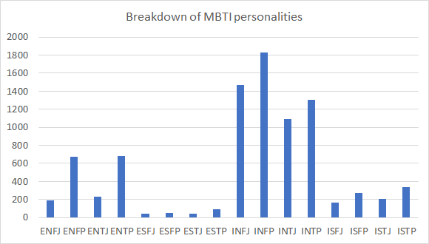
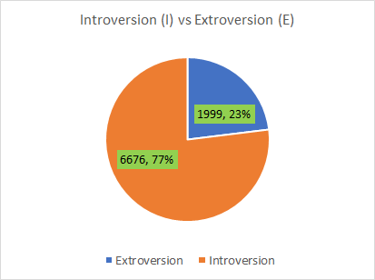
Visualising the dataset
The dataset contains 8600 instances in total. There are significantly more instances of Introversion (I) than Extroversion (E).
Notes:
There are 8600 instances in total, but the dataset is more skewed towards introverted individuals, who make up 77% of the records. In fact, the most frequent category, INFP alone makes up more than 20% of records with 1832 observations. One possible reason could be that introverted individuals are more likely to share their thoughts on the internet as compared to extroverts. Nevertheless, we still have close to 2000 records for extroverted individuals.

Slide 6
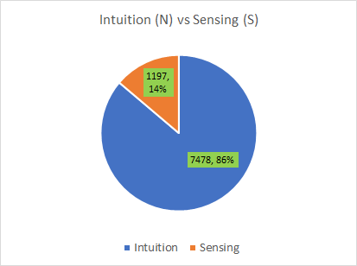
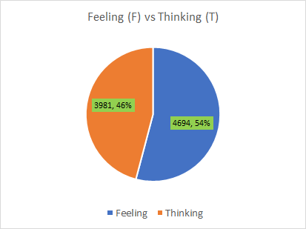
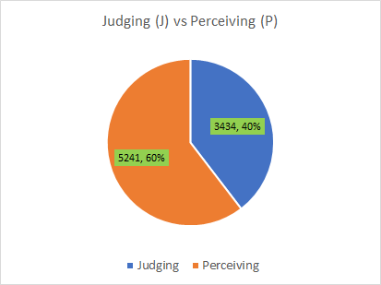
Visualising the dataset
For the remaining MBTI traits, there are more observations for Intuition (I) than Sensing (S). The other traits seem to be reasonably balanced in the number of occurrences.
Notes:
For the remaining traits, there are more observation for intuition at 86%, versus sensing which only makes up about 14%. The other traits seem to be reasonably balanced.

Slide 7
Preliminary Models using SKLEARN
Data Preprocessing
Removed all urls and special characters
Used WordNet lemmatizer to convert words to their base forms
E.g. “runs”, “ran”, “running” -> “run”
Label encoded target classes (16 MBTI personalities)
80:20 stratified train/test split for naive models
Tf-idf vectorizer on training and test sets
Notes:
Moving on to the naive models, we conducted some preprocessing on the data to remove urls and special characters from the column containing the social media posts. WordNet lemmatizer was also used to convert words to their base forms; for example, the words runs, ran and running would all be converted to run for a more accurate analysis. The 16 target classes have been tagged with integer labels using Label Encoder. Finally, we transformed both the test and training sets using the tf-idf vectorizer.

Slide 8
Model Performance
Base accuracy: 21.1% (by predicting that everyone is INFP - most common personality)
Among models tested, linear SVM with default parameters resulted in test accuracy of 66.2%
Model | Accuracy
Linear SVM | 0.662
Logistic Regression | 0.624
Decision Tree | 0.500
Random Forest | 0.488
Multinomial Naive Bayes | 0.376
Notes:
A naive model which predicts everyone to be INFP would have a base accuracy of 21.1%. We tested 5 naive models: linear SVM, logistic regression, decision trees, random forests and multinomial naive bayes. The most accurate model was linear SVM at 66.2%, which highly outperforms the base accuracy.

Slide 9
Limitations of SKLEARN models
Tf-idf does not catch position of words, semantic meanings of words
Lemmatizer is ineffective on records which contain several spelling errors
Semantic relations between different classes is lost when classes are label encoded using LabelEncoder( )
Notes:
There are some limitations and areas for improvement. The drawback of tf-idf is that it cannot capture the position of the words and their semantic meaning. The lemmatizer is ineffective on misspelled words which are not in the dictionary. Also, the semantic relations between different classes are lost when the different personalities are reduced to one-hot variables.

Slide 10
Neural Network Models using PyTorch
LSTM of fixed length inputs
Dropout = 0.3
Embedding dim = 200
Hidden dim = 200
Epochs = 20
Learning rate = 0.001
Model | Accuracy
LSTM (fixed length) | 0.211
Notes:
We also tested a basic LSTM model with the depicted parameters. However, the accuracy was only 21.1%, which is no better than the base accuracy.

Slide 11
Moving on...
Train data on different NN models
RNN, LSTM/GRU
Transformer
Pre-trained models
Notes:
Moving on, we still plan to use neural networks to tackle this classification problem. Some potential models include RNN, LSTM and transformer, which can also be coupled with pre-trained models such as BERT. While the current ML models we have extract features using Tf-idf, neural networks are able to extract the features by themselves, but we lose the interpretability of the models. The reason for continuing to use neural networks is because they can learn the positions and semantic meanings within the text, and we may be able to see a higher classification accuracy.
Normal - features extracted using Tf-idf
NN - let the NN itself learn the features (black-box method)

Slide 12
Thank You!

Slide 13
For the initial check-o (Week 8), the teams should describe the type of dataset selected
or collected, the problem they aim to address, data visualisation, and a preliminary naive
model implemented based on one dataset.
An initial presentation as described in Section 3. This component serves to provide
feedback and check that there is progress. It is worth 5 marks.

